Slide 1
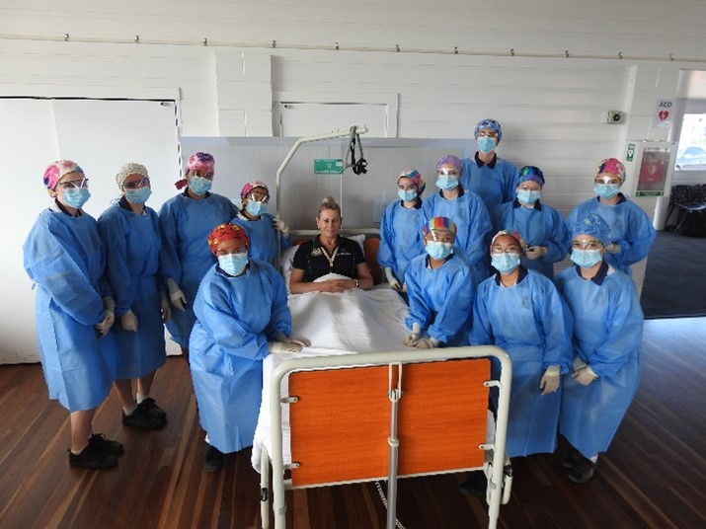
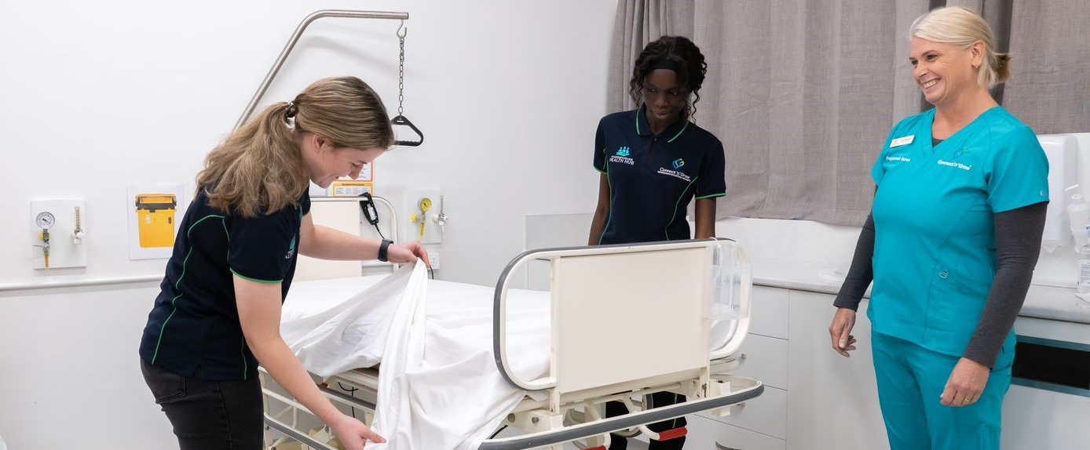
Thinking about a health career but don’t know where to start?
www.cyohealthcareer.com.au
Notes:
Before we go through a new and exciting interactive resource called Healthcare is Everywhere, I wanted to talk a bit about the health industry, why there is a growing need and why the health industry is an exciting avenue to work in.

Slide 2
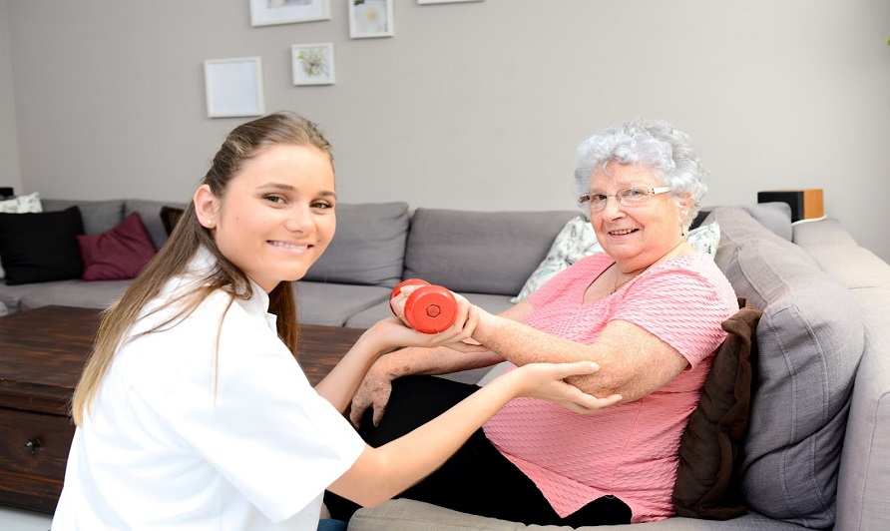
Why the health industry?
Fastest growing industry!
250,000 extra jobs predicted by 2023.
Health is everywhere!
Notes:
The Health Industry is the largest and fastest growing industry in Queensland and Australia.
The health industry is projected to grow by an additional 13.4% by 2023, the largest across all industries! (2018)
It is predicted there will be 250,300 new jobs by 2023.

Slide 3
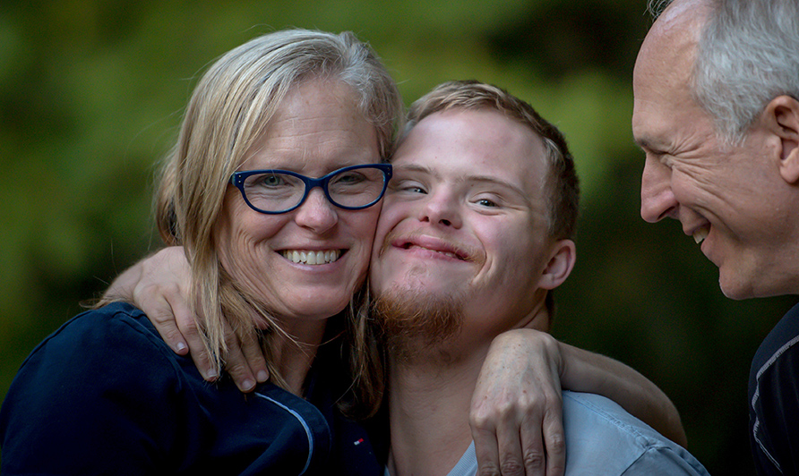
Jobs in the health industry
When you think of careers in the health industry, what types of jobs or occupations first come to mind?
Notes:
Did you know that jobs in health are much more than just doctors and nurses. There are a wide range of opportunities available to you and every career is an important element to deliver an effective health system for patients.
All the way from non-clinical roles such as trades working as contractors in hospitals, cleaners, food service assistants, health admin to more patient focused and clinical roles such as personal support workers, lifestyle coordinators, allied health assistants, pathology and nursing.
An in addition this, all of these roles can be achieved through a VET pathway where you can even start studying at school gaining valuable education and experience so that you are ready to enter the workforce directly after school.

Slide 4
Top health careers in Queensland
Notes:
This data helps to demonstrates the range of different health jobs and shows the top health occupations in Australia that can be achieved via a VET pathway.
The blue column shows the total current workforce and the orange column shows the future employment demand/projections. You can see there is a large demand for almost all jobs in health particularly aged and disabled carers, support workers, health service managers, dental assistants just to name a few.

Slide 5
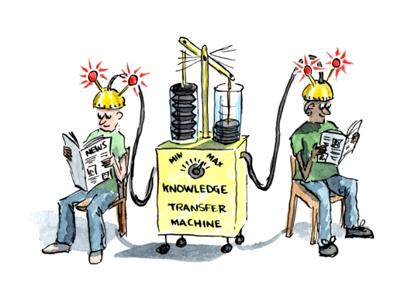
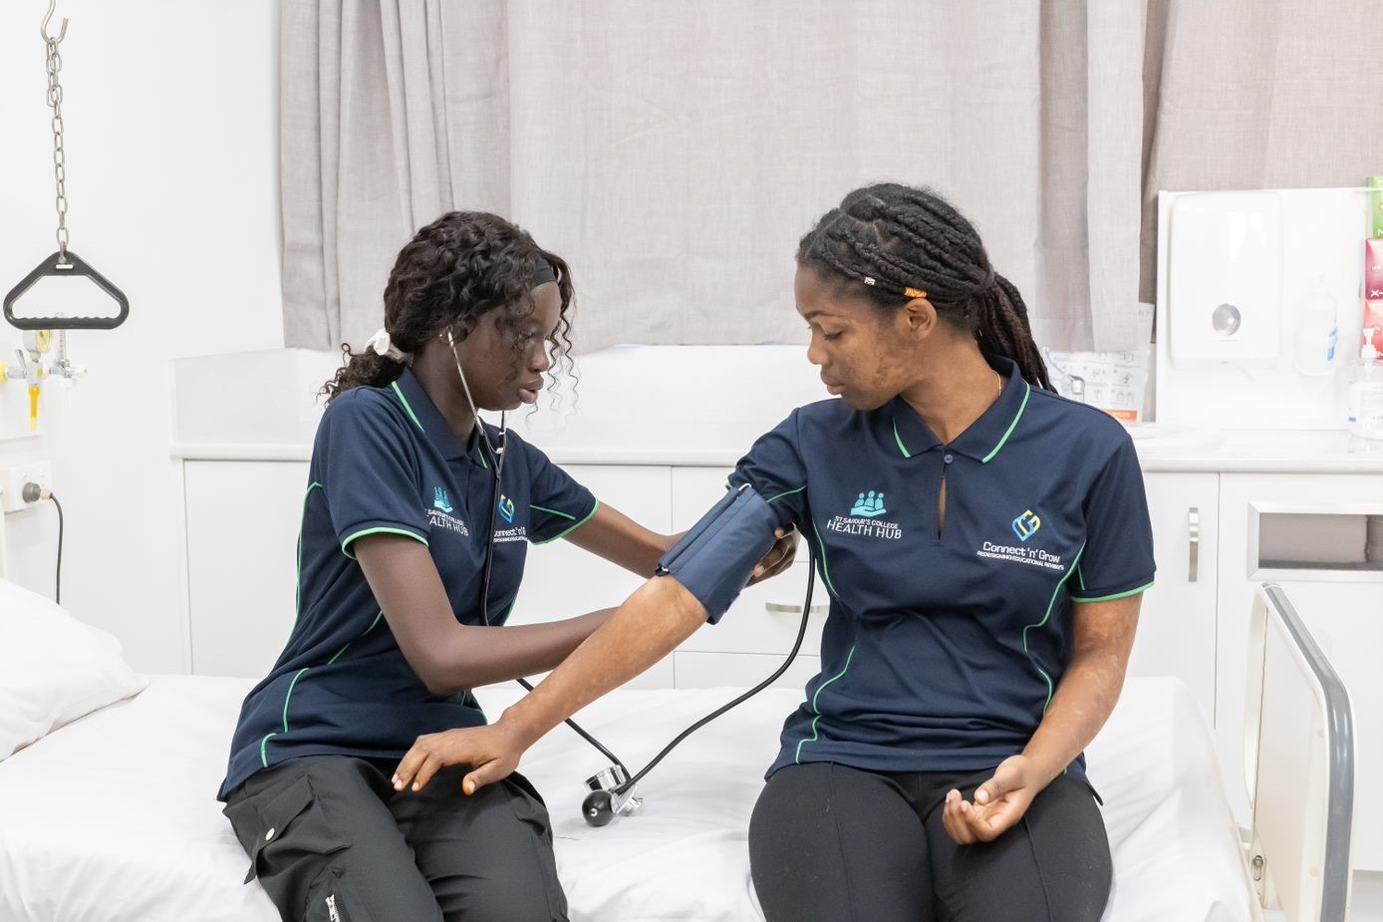
So why VET?
Start your career earlier!
Get paid while you learn!
Gain experience for the real world!
Skills and knowledge are transferrable!
VET offers flexibility!
This Photo by Unknown Author is licensed under CC BY-SA
Notes:
There are many benefits to undertaking a vocational education pathway.
Start your career earlier - Start studying at school and gain valuable education earlier!
Get paid while you learn - through apprenticeships and traineeships
Gain experience for the real world – get practical hands-on experience developing skills to make you work ready
VET offers flexibility – you can study full-time, part-time and through a combination of online, distance and face-to-face education
Skills and knowledge are transferable – to the same or even a different industry as well as providing a pathway to further study

Slide 6
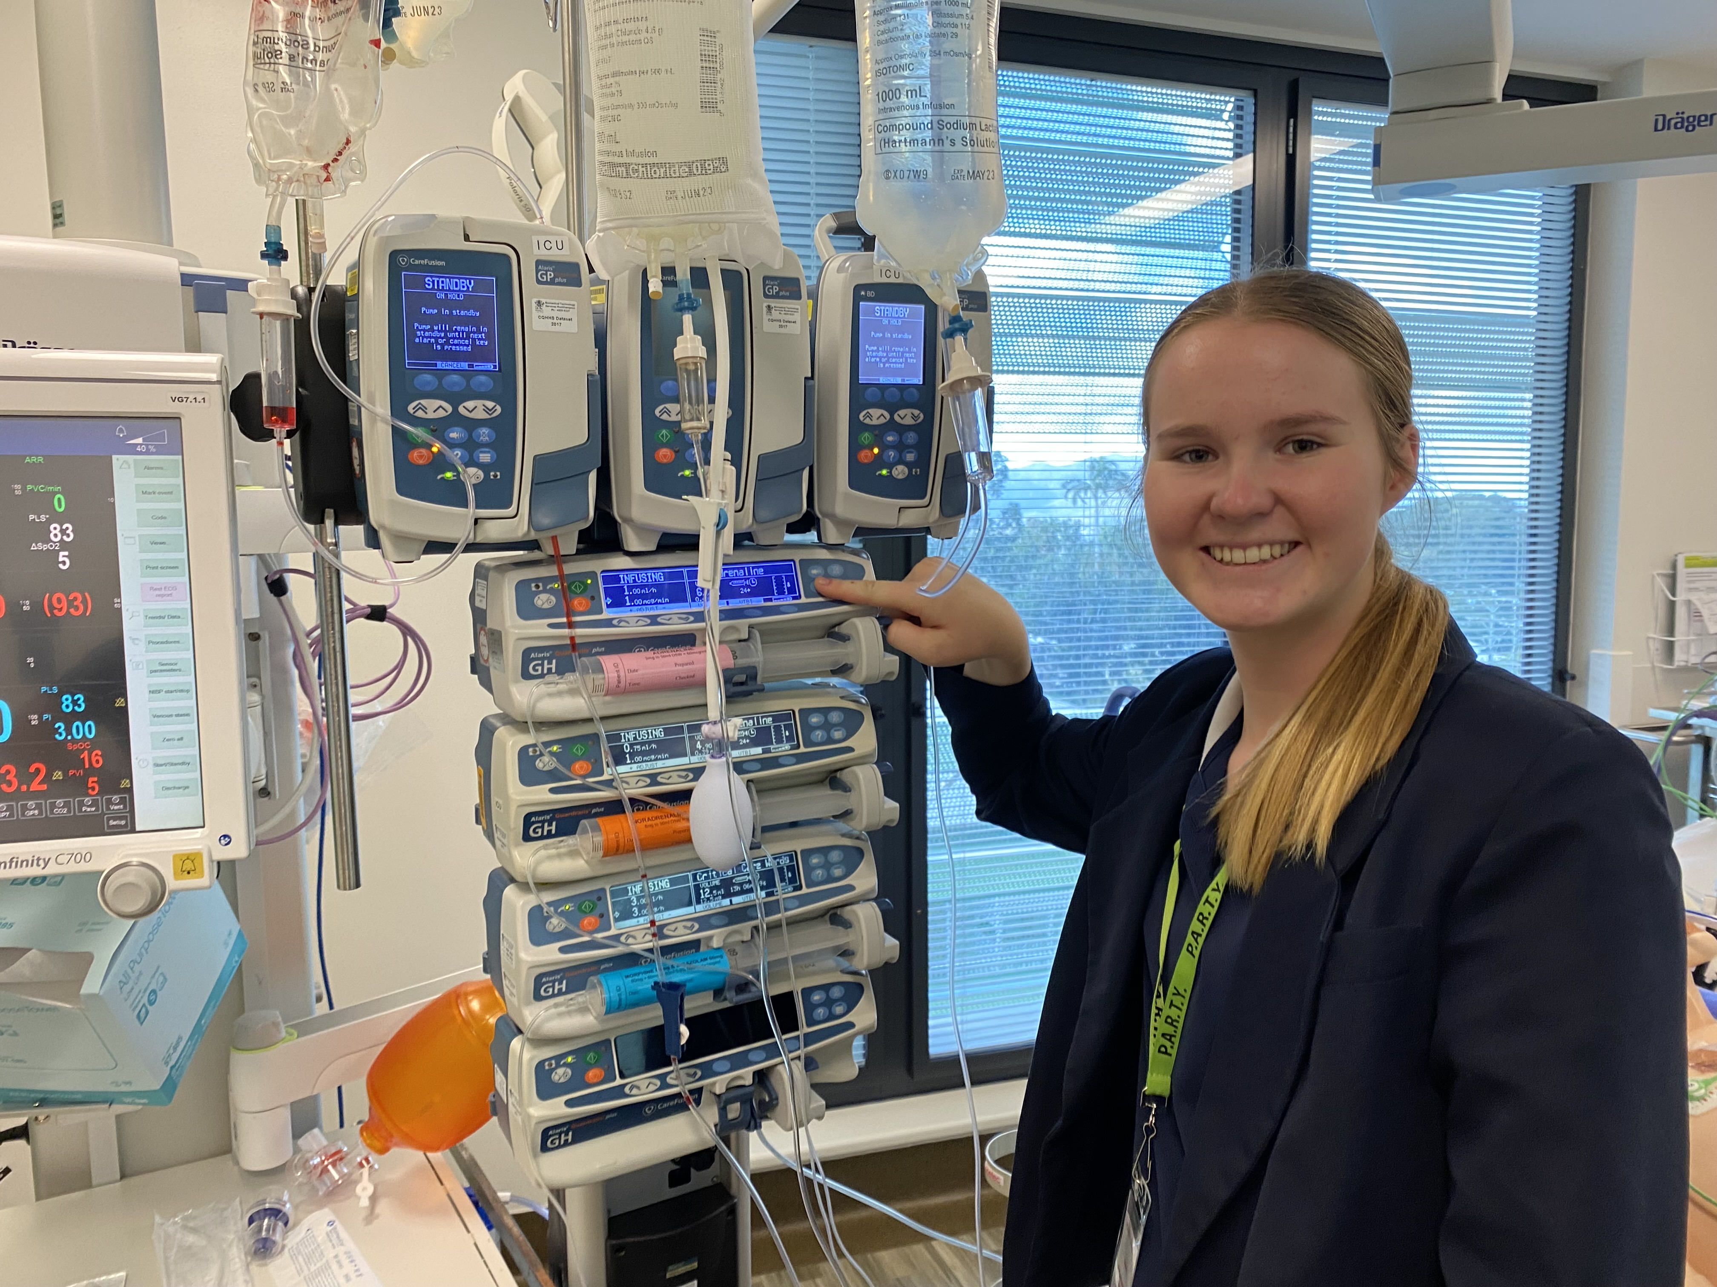
Personal skills and attributes
What are some of the skills and personal attributes that you might need to work in the health industry?
Notes:
[Ask students to list some skills and personal attributes needed to work in health]

Slide 7
Personal skills and attributes
Motivated to help
Communication skills
Caring/empathy/compassion
Attention to detail
Listening skills
Notes:
Key skills and personal attributes (these depend on the role and also if it’s a clinical or non-clinical role):
motivated by wanting to help others
attention to detail – record keeping is often require for most health roles
a strong sense of caring/empathy/compassion
good communication skills – able to interact well with people from all walks of life, particularly if wanting to work directly with patients
good listening skills – able to follow instructions and to listen to patients
for some roles, you can’t be squeamish to the sight of blood an other bodily fluids but there are so many non-clinical roles in the health industry that don’t necessarily provide direct patient care but are still an essential job within the health industry.

Slide 8
Healthcare is Everywhere – Online Interactive Tool
Notes:
So how can you find out more about the different careers in the health industry?
Did you know that healthcare is everywhere! Health is one of the few industries (along with education) that is everywhere, in every region. No matter where you live, health care is needed. This creates so many more opportunities across Australia and even the world.
To demonstrate the vast job opportunities in the health sector, the Health Gateway Program recently launched an interactive online tool called Healthcare is Everywhere. The aim of this tool is to increase awareness and understanding of the healthcare system and the variety of careers within the health industry. You can zoom in, scroll around and explore a hypothetical city and rural community and the range of health services and career opportunities available.

Slide 9
Hospital Jobs
What are some jobs/people who might work in a hospital?
Notes:
[Ask students to list some of the jobs in a hospital setting]

Slide 10
Hospital Jobs
Notes:
Let’s take a closer look!
NOTES: Click on the image to take you to Healthcare is Everywhere online – www.gateway2health.com.au/animation/ . Then click on Hospital and take students through some examples of roles in a hospital setting with particular emphasis on roles they may be unfamiliar with e.g. wardsperson, assistant in nursing, food services assistant, mental health workers, operating theatre assistant, health administration, maintenance, cleaning etc.

Slide 11
Aged Care Jobs
What are some jobs/people who might work in an Aged Care facility?
Notes:
[Ask students to list some of the jobs in an aged care setting]

Slide 12
Aged Care Jobs
Notes:
Let’s take a closer look!
NOTES: Click on the image to take you to Healthcare is Everywhere online - www.gateway2health.com.au/animation/ . Then click on Aged Care and take students through some examples of roles in an Aged Care setting with particular emphasis on roles they may be unfamiliar with e.g. personal support workers, diversional therapists, health services assistant, allied health assistants etc.

Slide 13
Exploring jobs in health – 10 minutes Resource: Student Worksheet
Student Activity - Explore Healthcare is Everywhere
www.gateway2health.com.au/animation/
Notes:
Give students ten minutes to work in pairs or individually and explore the Healthcare is Everywhere tool and encourage students to complete the student worksheet.
Students can access the resource using the web link on the slide or the QR code.

Slide 14
Questions
Question and discussion time
Notes:
NOTE: Ask students if they have any questions about particular health careers or wanted to share something interesting they’ve found in Healthcare is Everywhere

Slide 15
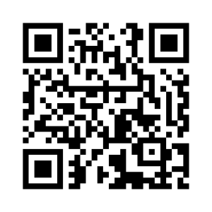
Want to learn more?
Scan the QR code to visit the CYO website.
www.cyohealthcareer.com.au
Notes:
You can access Healthcare is Everywhere interactive resource on the homepage of the Choose Your Own Health Career website.

